Slide 1


BVRIT HYDERABAD College of Engineering for Women Department of Computer Science & Engineering
Pulmonary and Lungs Nodule Classification Using Deep Learning
Team No: 20
M. Akshita 19WH1A0567
N. Shriya 19WH1A05B9
C. Priyanka 19WH1A05A2
Under the Guidance of :
Name: Ms. A. Kranthi
Designation: Assistant Professor

Slide 2
Table of Contents
Abstract
Introduction
Literature Survey
Existing System
Objective
Proposed System
Advantages
Architecture
Methodology
Dataset
Evaluation Metrics
Conclusion
Future Work
Publications
References

Slide 3
ABSTRACT
CT stands for computed tomography. It refers to a computerized x-ray imaging procedure in which a narrow beam of x-rays is aimed at a patient and quickly rotated around the body, producing signals that are processed by the machine’s computer to generate cross-sectional images.
The existence of pulmonary nodules exhibits the presence of lung cancer. The Computer-Aided Diagnostic (CAD) and classification of such nodules in CT images lead to improve the lung cancer screening. Lung nodules can be feature extracted from CT images using CNN.

Slide 4
INTRODUCTION
Cancer is a disease caused by an uncontrolled division of abnormal cells in a part of the body.
Among various types of cancers, lung cancer is the third most common type of cancer.
Lung carcinoma is characterized by malignant tumors from when gene changes in the DNA of the cells, mutate and promote unnatural growth. Lung cancer is the most common type of cancer. .

Slide 5
INTRODUCTION(cont..)
Computed tomography (CT) produces a series of cross-sectional images covering a part of the human body. And analyzing these CT images to predict the lung nodules. And classify the CT images.
Lung cancer can be further classified into:
Adeno carcinoma
Large cell carcinoma
Squamous cell carcinoma
The Computer-Aided Diagnostic (CAD) systems use CNN to classify the images.

Slide 6
LITERATURE SURVEY
S.No | Title of the paper | Author(s) & Journal Details | Description/Interpretation
1 | Pulmonary Nodule Classification Using Feature and Ensemble Learning-Based Fusion Techniques | MUHAMMAD MUZAMMIL, IEEE Access (Volume 9), 2021 | Proposed Work : SVM and AdaBoostM2 machine learning algorithms are trained on the deep features. Future Work : CNN based medical image fusion method to fuse the CT and MR images as the future work.
2 | LDNNET: Towards Robust Classification of Lung Nodule and Cancer Using Lung Dense Neural Network | YERONG WANG, IEEE Access (Volume 9), 2021 | Proposed Work : LDNNET uses Dense Blocks on LUNA and DSB datasets and gets accuracy higher for a dataset based on parameter values like dense connection, input image size. Future Work : Merging the features of different types of medical images, for instance, brain CT images, liver CT images, bone CT images and so on, to achieve more accurate and more robust medical image classification
3 | Research on the Auxiliary Classification and Diagnosis of Lung Cancer Subtypes Based on Histopathological Images | MIN LI , XIAOJIAN MA, IEEE Access (Volume 9), 2021 | Proposed Work : Lung Cancer histopathological image classification using Relief-SVM into sub types ASC, LUSC, SCLC. Future Work : CNNs are challenged to classify lung cancer into subtypes using histopathological images.
4 | Memory-Augmented Capsule Network for Adaptable Lung Nodule Classification | Aryan Mobiny , Pengyu Yuan, IEEE Transaction on Medical Imaging(Volume: 40), 2021 | Proposed Work : Practical adaptive classifier called MEMCAP which is capable of taking a few annotated inputs from a new target domain to refine its decision making ability accordingly to classify lung images. Future Work : Integrating MEMCAP into OCT skin lesion analysis in order to address both the data scarcity and resolution variability of the data.

Slide 7
LITERATURE SURVEY
S.No | Title of the paper | Author & Journal Details | Description/Interpretation
5 | A Lightweight Multi-Section CNN for Lung Nodule Classification and Malignancy Estimation | Pranjal Sahu , Dantong Yu, IEEE Journal of Biomedical and Health Informatics (Volume: 23), 2019 | Proposed Work : Multi-section CNN to obtain its performance under various settings like using only Axial cross-section and using the three orthogonal cross-sections. Future Work : An automated nodule detection algorithm to assist the practitioner in identifying and locating a suspicious nodule from a large image of CT scan.
6 | Bioimpedance Spectroscopy Measurement and Classification of Lung Tissue to Identify Pulmonary Nodules | Rasool Baghbani , Mohammad Behgam Shadmehr, IEEE Transactions on Instrumentation and Measurement (Volume: 70), 2021 | Proposed Work : Smart system was designed based on the bio impedance phase and magnitude to differentiate healthy lung tissue from the tumoral lung tissue using SVM, KNN, LDA. Future Work : Bioimpedance spectroscopy and machine learning to automatically localize deep pulmonary nodules during surgery.
7 | Lung Nodule Malignancy Prediction in Sequential CT Scans: Summary of ISBI 2018 Challenge | Yoganand Balagurunathan , Andrew Beers, IEEE Transactions on Medical Imaging (Volume: 40), 2021 | Proposed Work : Demonstrated the effectiveness of screening using low dose CT (LDCT) in reducing lung cancer related mortality. Future Work : The need for improved infrastructure for better international data distribution, and software support for users interacting with unfamiliar data formats.
8 | Self-Supervised Transfer Learning Based on Domain Adaptation for Benign-Malignant Lung Nodule Classification on Thoracic CT | Yuan Li, and Chao Peng, IEEE Journal of Biomedical and Health Informatics (Volume: 26), 2022 | Proposed Work : The spatial heterogeneity is an important indicator of the malignancy of lung nodules and algorithm to classify this is self-supervised transfer learning based on domain adaptation (SSTL-DA) 3D CNN Framework. Future Work : SSTL-DA method have high computational cost and reducing this time consumption is needed.

Slide 8
LITERATURE SURVEY
S.No | Title of the paper | Author(s) & Journal Details | Description/Interpretation
9 | Knowledge-based Collaborative Deep Learning for Benign-Malignant Lung Nodule Classification on Chest CT | Yutong Xie, IEEE Transactions on Medical Imaging (Volume: 38), 2019 | Proposed Work : Multi-view knowledge-based collaborative (MV-KBC) deep model to separate malignant from benign nodules using limited chest CT data. Future Work: Extend to a semi-supervised learning framework, such that we can use the nodules with an uncertain level of malignancy and unlabeled nodules as training samples to reduce the need for data annotation.
10 | Modified Quality Threshold Clustering for Temporal Analysis and Classification of Lung Lesions | Stelmo Magalhaes Barros Netto, IEEE Transactions on Image Processing (Volume: 28), 2019 | Proposed Work : A modified version of the quality threshold clustering algorithm to associate each voxel of the lesion to a cluster, and changes in the lesion over time are defined in terms of voxel moves to another cluster. Future Work: To incorporate an analysis based on stratification of malignant lesions and correlate the results with medical clinical data.
11 | Lung Sound Classification Using Co-Tuning and Stochastic Normalization | Truc Nguyen and Franz Pernkopf, IEEE Transactions on Biomedical Engineering (Volume:69), 2022 | Proposed Work : Lung sounds like respiratory cycles/ recordings are classified using feature processing and classification. Future Work: Based on lung sound class adventitious we can better model for better accuracy.
12 | Geometric Structural Ensemble Learning for Imbalanced Problems | Zonghai Zhu, Zhe Wang , Dongdong Li, IEEE Transactions on Cybernetics (Volume: 50), 2020 | Proposed Work : GSE partitions and eliminates redundant majority samples by generating hyper-sphere through the Euclidean metric and learns basic classifiers to enclose the minority samples. Future Work : The error functions, which represent the properties of the pruned area, should be designed to make the relaxation technique more robust.

Slide 9
EXISTING SYSTEM
The lung nodules are classified as cancerous or not in the existing system. GoogLeNet and ResNet are used for feature extraction. For these features train SVM to estimate the probability scores.
Classify CT scans as cancerous or not.

Slide 10
OBJECTIVE
Our main objective of the project is to help the doctors to analyze CT
images of lungs to predict the presence of nodules which classifies the
lung as cancerous or not. Along with classifying the type of cancer if a
lung nodule exists.

Slide 11
PROPOSED SYSTEM
Proposing is a system where the lung nodules are classified using deep
learning techniques like a VGG16, InceptionV3. The nodules are classified
into 3 classes namely :
Adeno carcinoma
Large cell carcinoma
Squamous cell carcinoma

Slide 12
ADVANTAGES
Classification of the cancerous lungs further
Good Performance

Slide 13
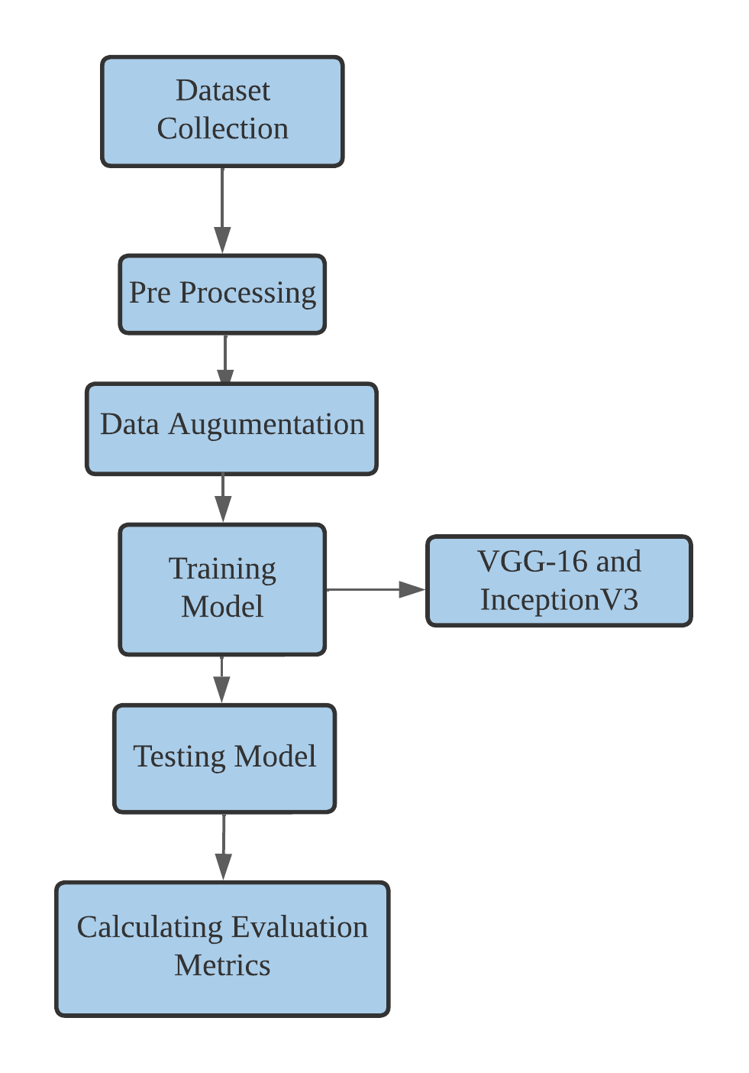
ARCHITECTURE

Slide 14
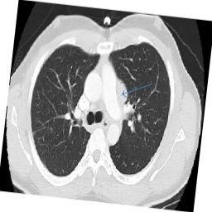
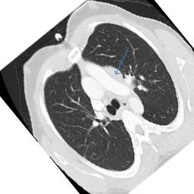
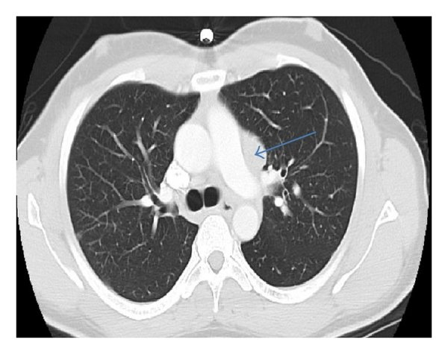
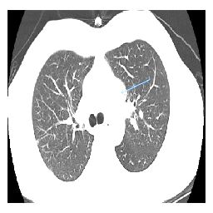
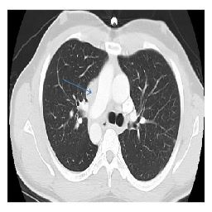
METHODOLOGY
Data Augmentation Architecture
Rotation range : 20
Rotation range : 180
Lung Image
Brightened
Horizontal Flip

Slide 15
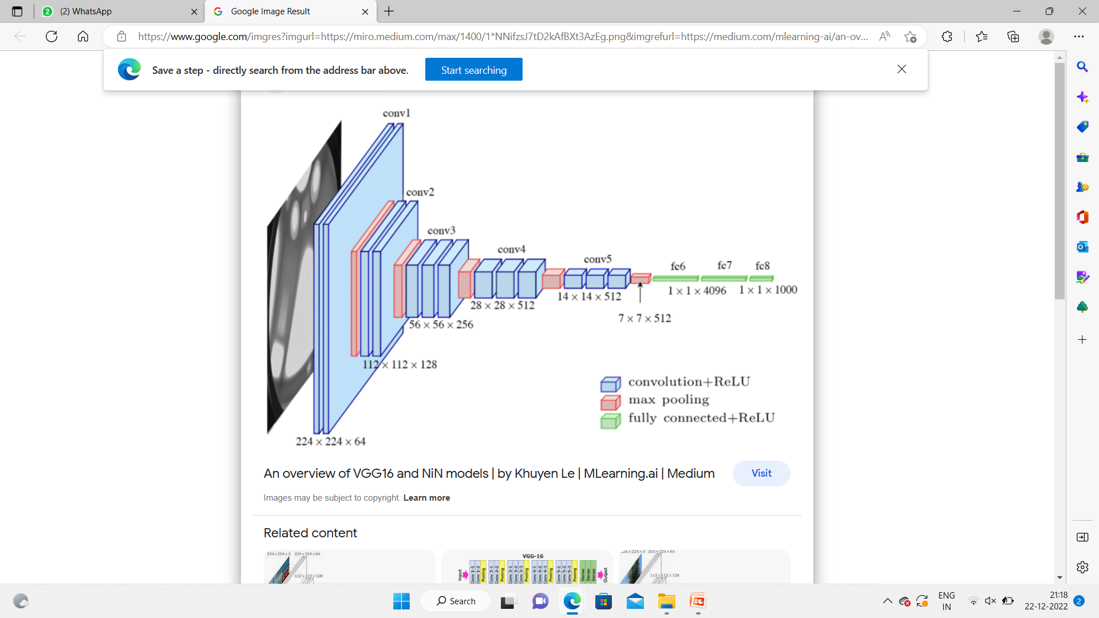
METHODOLOGY(Cont..)
VGG16 Architecture

Slide 16
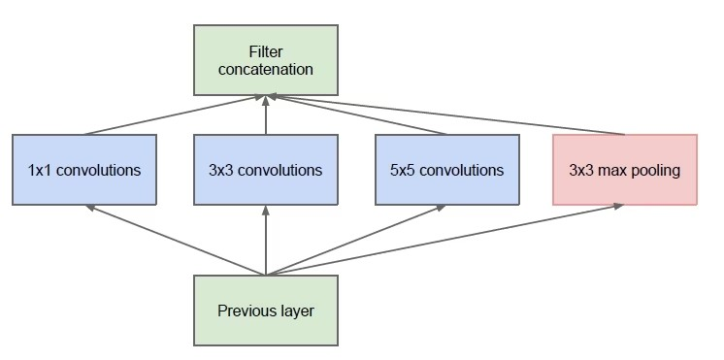
METHODOLOGY(Cont..)
InceptionV3 :
Naive Form

Slide 17
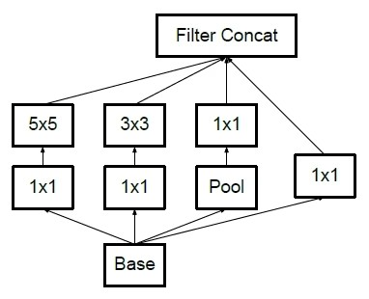
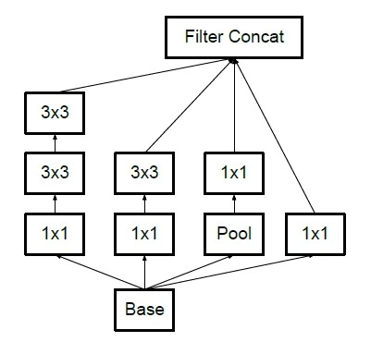
METHODOLOGY(Cont..)
Factorization into Smaller Convolutions

Slide 18
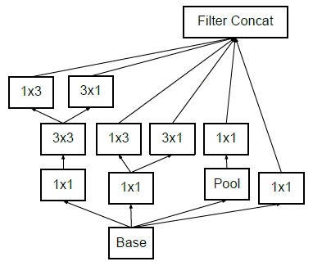
METHODOLOGY(Cont..)
Spatial Factorization into Asymmetric Convolutions

Slide 19
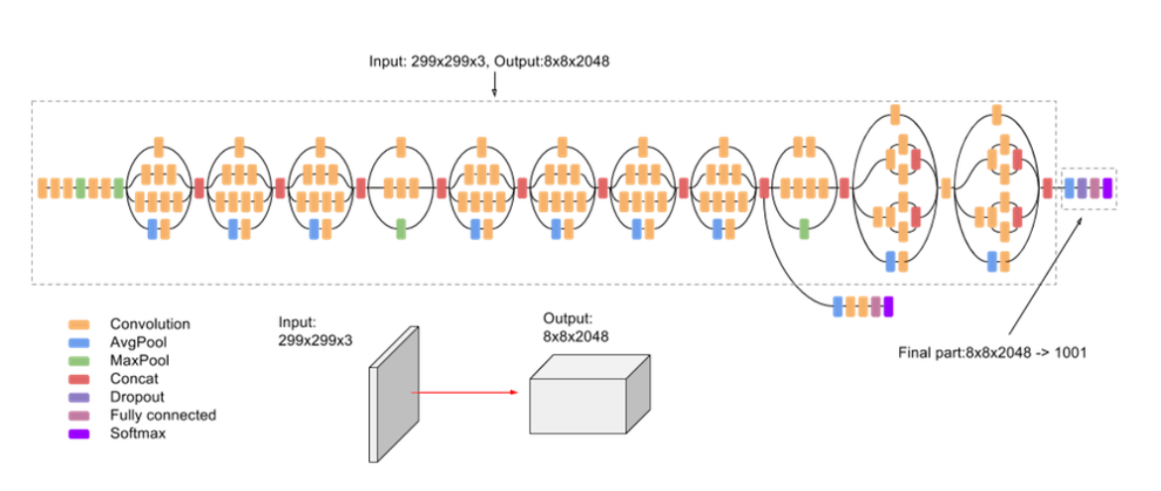
METHODOLOGY(Cont..)
InceptionV3 Architecture

Slide 20

METHODOLOGY(Cont..)
Tabular Representation

Slide 21
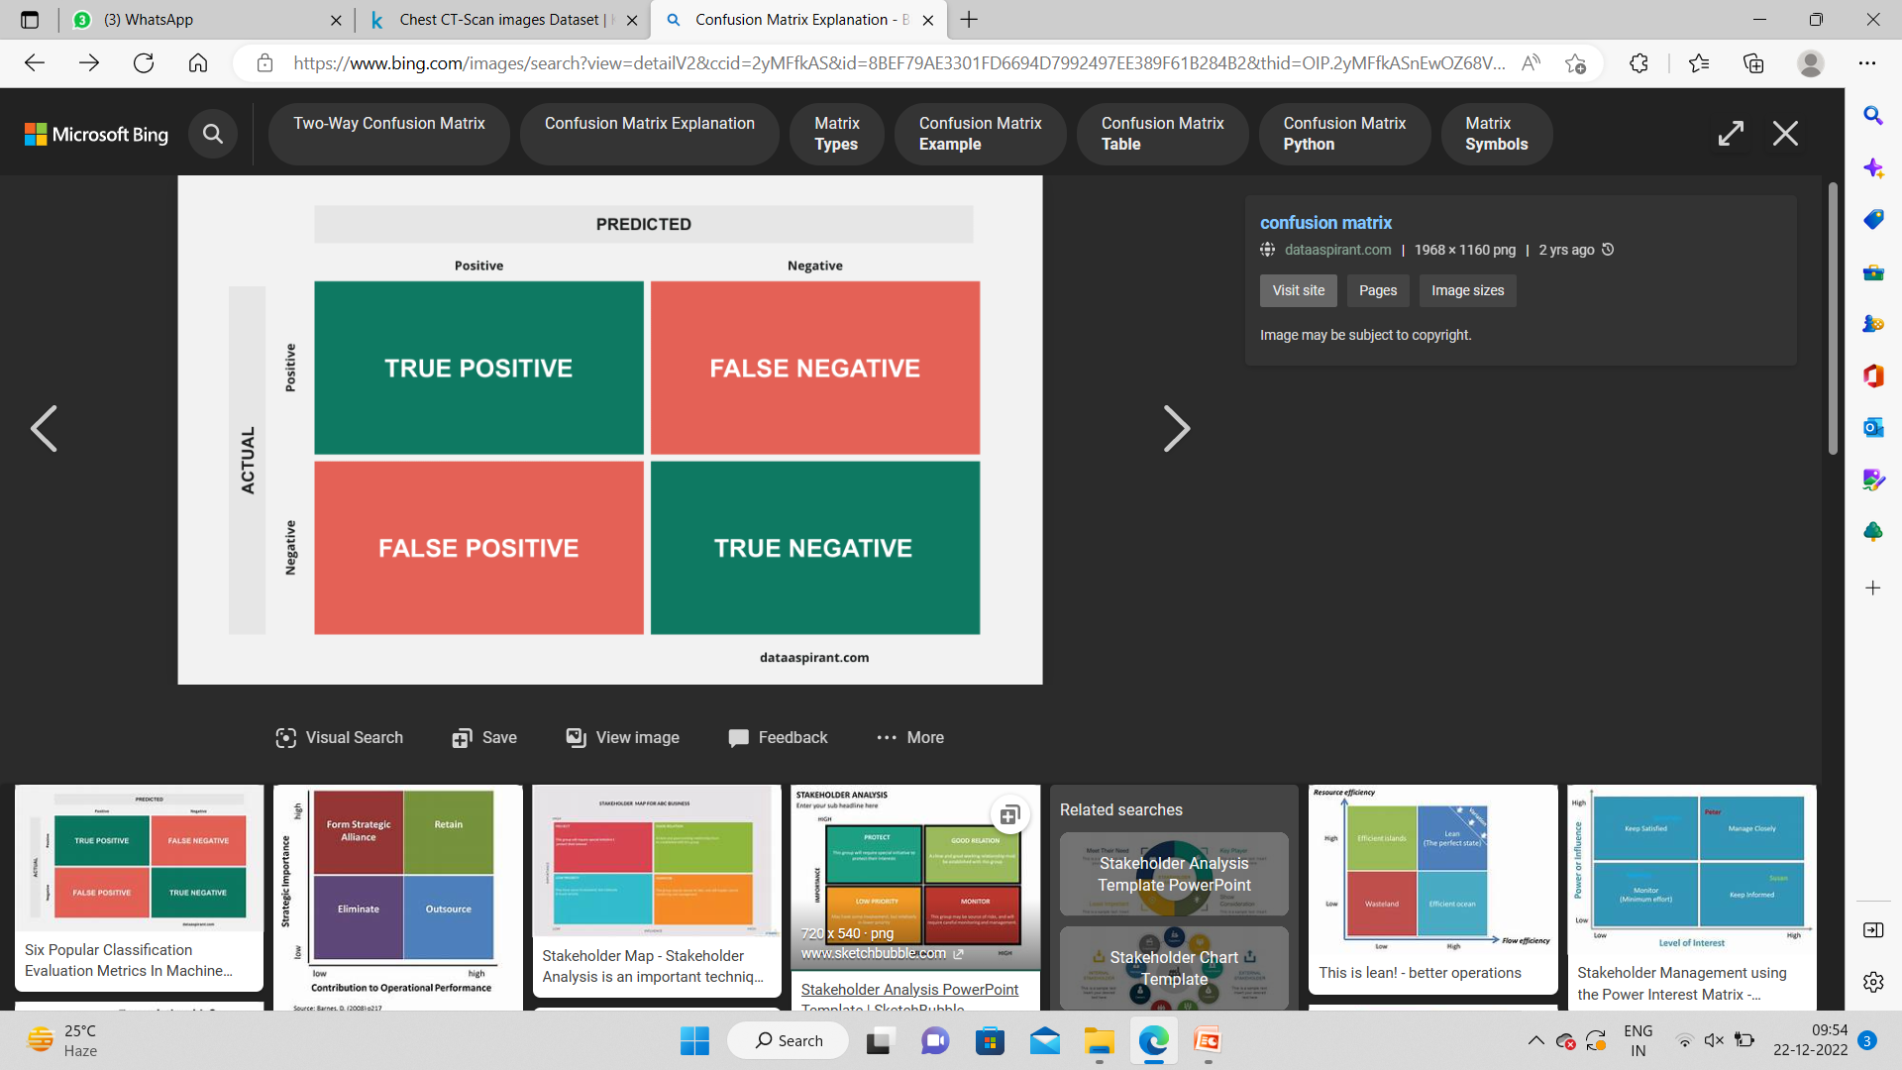
EVALUATION METRICS
CONFUSION MATRIX
TN + TP
ACCURACY =
TN + FP + TN + FN

Slide 22
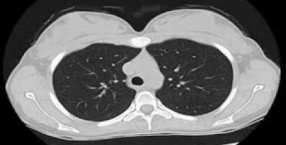
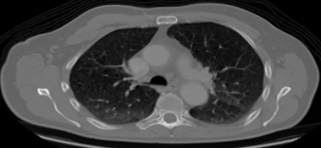
DATASET
https://www.kaggle.com/datasets/mohamedhanyyy/chest-ctscan-images
Dataset type : Images
Dataset size : 124MB
No. of Images : 1000 {train = 613 (148 : 465), validate = 72 (13 : 59), test = 315 (54: 261)}
No. of classes : 4
Normal Lung
Cancer Lung
Sample Images

Slide 23
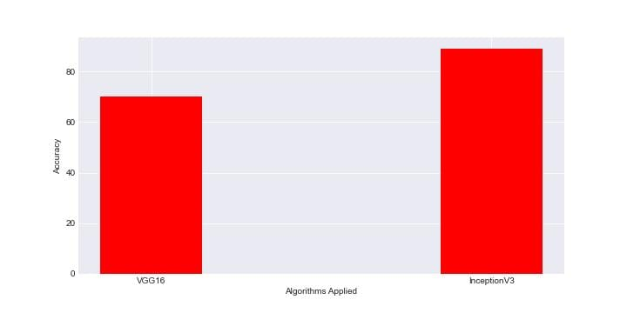
RESULTS

Slide 24
CONCLUSION
We could predict lung nodules using VGG-16 model with an accuracy of 70% and using Inception V3 with accuracy of 89%.

Slide 25
FUTURE WORK
Further division of lung nodules
Reducing the computation time

Slide 26
PUBLICATIONS
Ms. Shanmuga Sundari, Ms. A. Kranthi, Mogullapalli Akshita, Nimmala Shriya Reddy, Challa Priyanka presented a paper "Pulmonary and Lung Nodule Classification using Deep Learning" on 8th International Conference on Computing, Communication and Security (ICCCS-2023) organized by Baba Farid College of Engineering and Technology Bathinda, Punjab (India), March 03-04, 2023
Publication will be in reputed Scopus

Slide 27
REFERENCES
[1] MUHAMMAD MUZAMMIL, IMDAD ALI, IHSAN UL HAQ, AMIR A. KHALIQ, AND SUHEEL ABDULLAH, “Pulmonary Nodule Classification Using Feature and Ensemble Learning-Based Fusion Techniques”, IEEE Access, vol. 9, pages. 113415 - 113427, 05 August 2021.
[2] YING CHEN , YERONG WANG , FEI HU, LONGFENG FENG,TAOHUI ZHOU, AND CHENG ZHENG, “LDNNET: Towards Robust Classification of Lung Nodule and Cancer Using Lung Dense Neural Network”, IEEE Access, vol. 9, pages. 50301 - 50320, 24 March 2021.
[3] MIN LI, XIAOJIAN MA, CHEN CHEN, YUSHUAI YUAN, SHUAILEI ZHANG, ZIWEI YAN, CHENG CHEN, FANGFANG CHEN, YUJIE BAI, PANYUN ZHOU, XIAOYI LV, AND MINGRUI MA, “Research on the Auxiliary Classification and Diagnosis of Lung Cancer Subtypes Based on Histopathological Images”, IEEE Access, vol. 9, pages. 53687 - 53707, 05 April 2021.
[4] Qiangchang Wang , Yuanjie Zheng, Gongping Yang , Weidong Jin, Xinjian Chen, and Yilong Yin, “Multiscale Rotation-Invariant Convolutional Neural Networks for Lung Texture Classification”, IEEE JOURNAL OF BIOMEDICAL AND HEALTH INFORMATICS, VOL. 22, NO. 1, JANUARY 2018.
[5] Aryan Mobiny , Pengyu Yuan, Pietro A. Cicalese , Supratik K. Moulik, Naveen Garg, Carol C. Wu ,Kelvin Wong, Stephen T. Wong, Fellow, IEEE, Tian Cheng He , and Hien V. Nguyen, “Memory-Augmented Capsule Network for Adaptable Lung Nodule Classification”, IEEE TRANSACTIONS ON MEDICAL IMAGING, VOL. 40, NO. 10, OCTOBER 2021.
[6] Pranjal Sahu , Dantong Yu, Mallesham Dasari , Fei Hou , and Hong Qin, “A Lightweight Multi-Section CNN for Lung
Nodule Classification and Malignancy Estimation”, IEEE JOURNAL OF BIOMEDICAL AND HEALTH INFORMATICS, VOL. 23, NO. 3, MAY 2019.
[7] Rasool Baghbani , Mohammad Behgam Shadmehr , Masoomeh Ashoorirad ,Seyyedeh Fatemeh Molaeezadeh , and Mohammad Hassan Moradi, “Bioimpedance Spectroscopy Measurement and Classification of Lung Tissue to Identify Pulmonary Nodules”, IEEE TRANSACTIONS ON INSTRUMENTATION AND MEASUREMENT, VOL. 70, 2021.

Slide 28
REFERENCES
[8] Yoganand Balagurunathan , Andrew Beers, Michael McNitt-Gray , Member, IEEE, Lubomir Hadjiiski, Senior Member, IEEE, Sandy Napel , Life Member, IEEE,Dmitry Goldgof , Fellow, IEEE, Gustavo Perez ,, “Lung Nodule Malignancy Prediction in Sequential CT Scans: Summary of ISBI 2018 Challenge”, IEEE TRANSACTIONS ON MEDICAL IMAGING, VOL. 40, NO. 12, DECEMBER 2021.
[9] Hong Huang , Member, IEEE, Ruoyu Wu, Yuan Li, and Chao Peng, “Self-Supervised Transfer Learning Based on Domain Adaptation for Benign-Malignant Lung Nodule Classification on Thoracic CT”, IEEE JOURNAL OF BIOMEDICAL AND HEALTH INFORMATICS, VOL. 26, NO. 8, AUGUST 2022.
[10] Yutong Xie, Yong Xia , Member, IEEE, Jianpeng Zhang, Yang Song, Member, IEEE, Dagan Feng , Fellow, IEEE, Michael Fulham, and Weidong Cai , Member, IEEE, “Knowledge-based Collaborative Deep Learning for Benign-Malignant Lung Nodule Classification on Chest CT”, IEEE TRANSACTIONS ON MEDICAL IMAGING, VOL. 38, NO. 4, APRIL 2019.
[11] Stelmo Magalhaes Barros Netto , Joao Otavio Bandeira Diniz, Aristofanes Correa Silva, Anselmo Cardoso de Paiva , Rofolfo Acatauassu Nunes, and Marcelo Gattass, “Modified Quality Threshold Clustering for Temporal Analysis and Classification of Lung Lesions”, IEEE TRANSACTIONS ON IMAGE PROCESSING, VOL. 28, NO. 4, APRIL 2019.
[12] Truc Nguyen and Franz Pernkopf , Senior Member, IEEE, “Lung Sound Classification Using Co-Tuning and Stochastic Normalization”, IEEE TRANSACTIONS ON BIOMEDICAL ENGINEERING, VOL. 69, NO. 9, SEPTEMBER 2022.
[13] Pin Lim, Student Member, IEEE, Chi Keong Goh, Senior Member, IEEE, and Kay Chen Tan, Fellow, IEEE, “Evolutionary Cluster-Based Synthetic Oversampling Ensemble (ECO-Ensemble) for Imbalance Learning”, IEEE TRANSACTIONS ON CYBERNETICS, VOL. 47, NO. 9, SEPTEMBER 2017.
[14] Zonghai Zhu, Zhe Wang , Dongdong Li, Yujin Zhu, and Wenli Du, “Geometric Structural Ensemble Learning for Imbalanced Problems”, IEEE TRANSACTIONS ON CYBERNETICS, VOL. 50, NO. 4, APRIL 2020.
[15] Geoffrey I. Webb, Member, IEEE, and Zijian Zheng, “Multistrategy Ensemble Learning: Reducing Error by Combining Ensemble Learning Techniques”, IEEE TRANSACTIONS ON KNOWLEDGE AND DATA ENGINEERING, VOL.16,NO.8, AUGUST 2004.

Slide 29
THANK YOU

